Slide 1


Arjun College of Technology
(Approved by AICTE & Affiliated to Anna University)
Coimbatore – Pollachi Highway, Thamaraikulam, Coimbatore- 642120
ONLINE ATTENDANCE SYSTEM
PRESENTED BY
CHUNCHU. MANOJ (723920104015)
MADDELA. PRAVEEN (723920104037)
TOTAMSETTY. SAI CHARAN (723920104059)
GUIDED BY
Ms.M.ESTHER MAGTHALENE ANNE MCA.,B.Ed.,

Slide 2
AGENDA
Abstract
Introduction
Tools Used
Existing System
Disadvantages
Proposed System
Advantage
System Specification
Implementation
Conclusion
References

Slide 3
ABSTRACT
The manual attendance management has been carried more Time to take attendance and calculate percentage of Attendance.
To overcome the problems of manual attendance, We want to develop “web-based attendance system”, It is based on web server.
In This application, PHP is server-side language, MYSQL and PHP is used as backend design and HTML,CSS and Javascript are used as frontend tools.

Slide 4
INTRODUCTION
In today's world, technology has made our lives easier in many ways.
The traditional method of taking attendance manually is time-consuming and prone to errors.
Online attendance systems have become popular in recent years due to their convenience and accuracy.
An online attendance system using HTML, CSS, JavaScript, PHP, and MySQL can help schools, universities, and companies manage attendance efficiently.
This system can be accessed from anywhere with an internet connection, making it easy for students, teachers.

Slide 5
TOOLS USED
Frontend : Html, Css, Java Script
Backend : MySql, Php

Slide 6
EXISTING SYSTEM
The Existing system is a manual entry for the students.
Here the attendance will be carried out in the hand written registers.
It will be a tedious job to maintain the record for the user.
The human effort is more here.
The retrieval of the information is not as easy as the records are maintained in the hand written registers.
Suppose the wrong inputs are entered, the application resist to work so the user find it difficult to use.

Slide 7
DISADVANTAGE
Expensive and time consuming.
Too much paper work.
Error during data entry.
Loss of registration forms.

Slide 8
PROPOSED SYSTEM
To overcome the drawbacks of the existing system, the proposed system has been evolved.
This Project aims to reduce the paper work and saving time to generate accurate results from the student’s attendance.
The system provides with the best user interface.
The efficient reports can be generated by using this Proposed system.
In the Proposed system I have implemented ,Sections Like Class and Year also percentage of the attendance and date and time have added.

Slide 9
ADVANTAGE
Security and integrity.
It is trouble-free to use.
It is a relatively fast approach to enter attendance.
Best user interface.
Easy to accessibility.
Efficient Reports.
Cost saving.

Slide 10
SYSTEM SPECIFICATION
HAREWARE REQUIREMENTS
Hard disk : 40GB
RAM : 4.00 GB
System type 64-bit operating system, x64-based processor

Slide 11
SYSTEM SPECIFICATION
SOFTWARE REQUIREMENTS
Web Server : XAMPP Server
Database : MySQL, PostgreSQL, or SQL Server.
Programming Language : PHP.
Front-end Framework : HTML,CSS,JS.

Slide 12
IMPLEMENTATION
Module Split up
Faculty
Student

Slide 13
FLOW DIAGRAM
Student Dashboard
View attendance
Exit
Attendance
Faculty login
Take attendance
View attendance
Logout

Slide 14
Module 1: FACULTY
Actions can be performed by Faculty:
Add/Remove Class
Add/Remove Student
Take Attendance
See the result
See the Percentage

Slide 15
Module 2: STUDENT
Actions can be performed by Student:
See their Result
Average Percentage

Slide 16
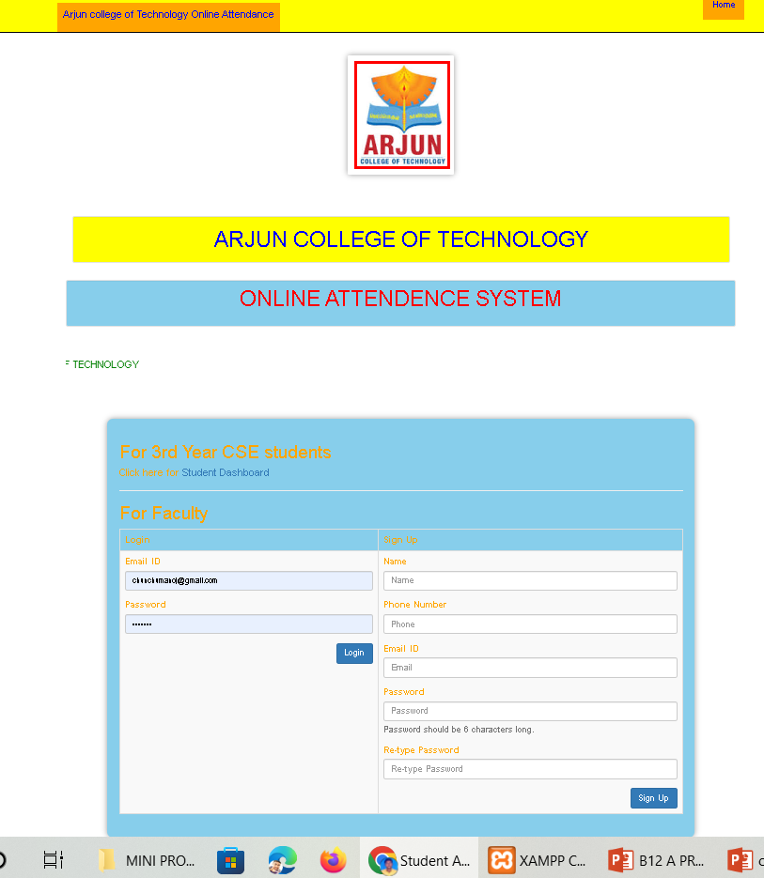
FACULTY LOGIN PAGE

Slide 17
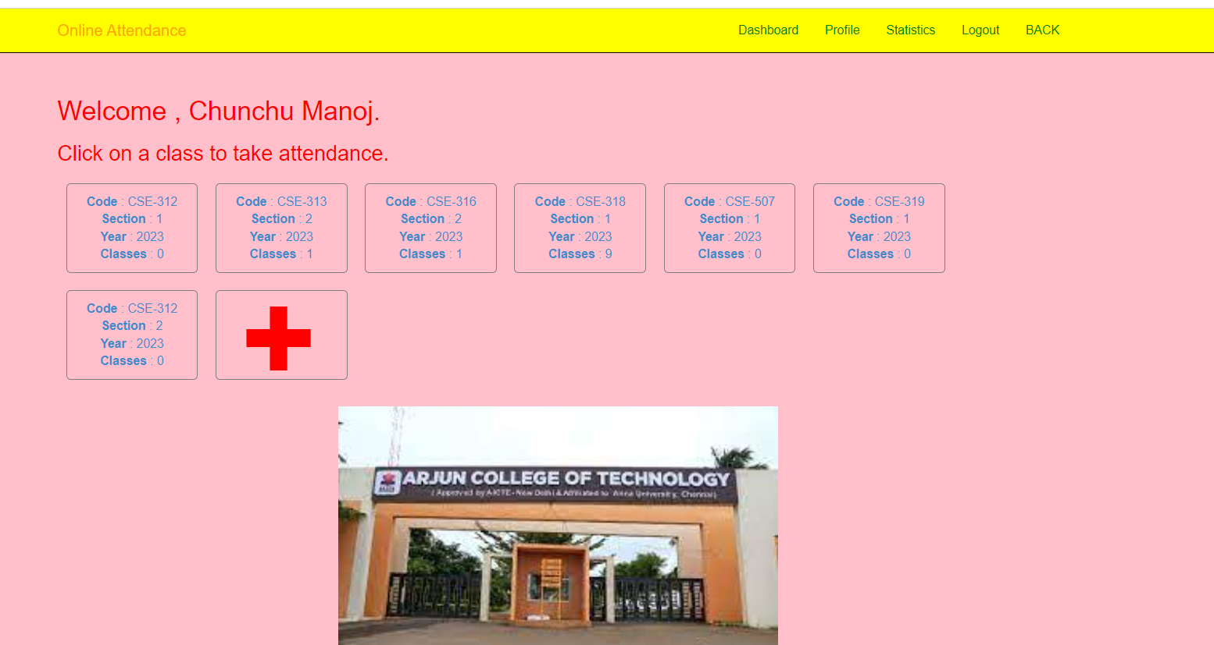
ADDED CLASSES

Slide 18
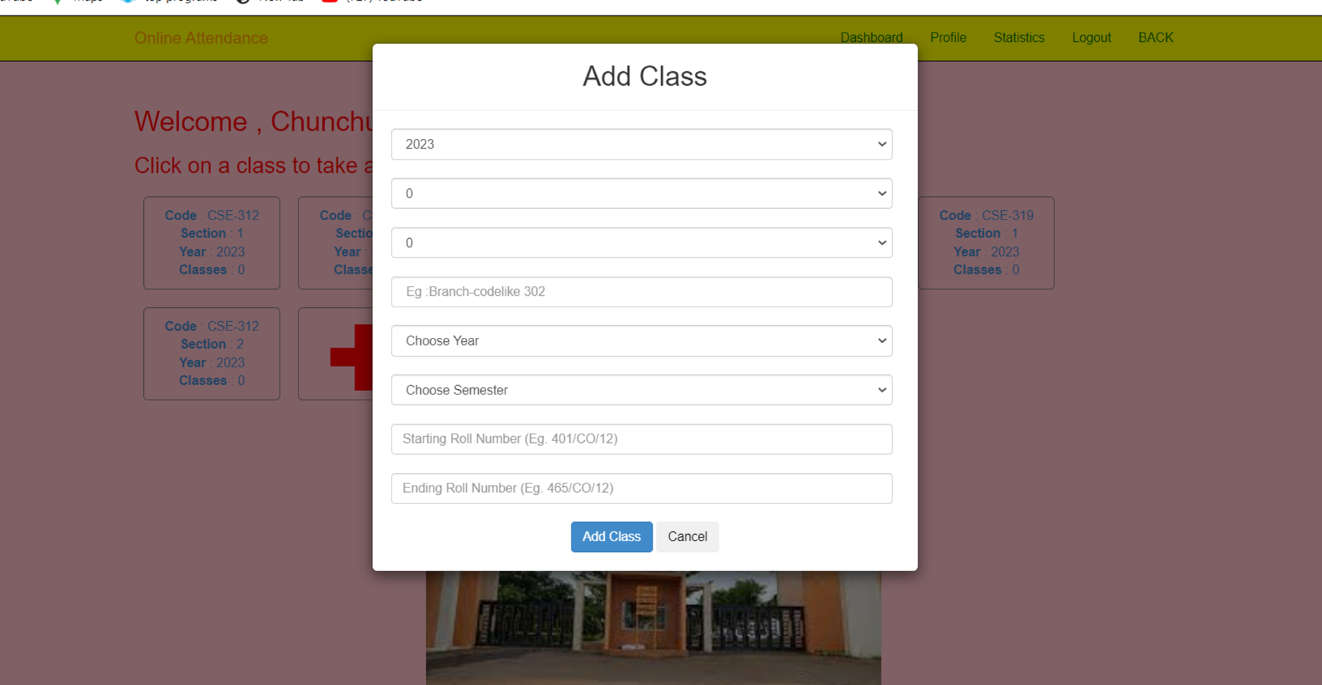
ADD NEW CLASS

Slide 19
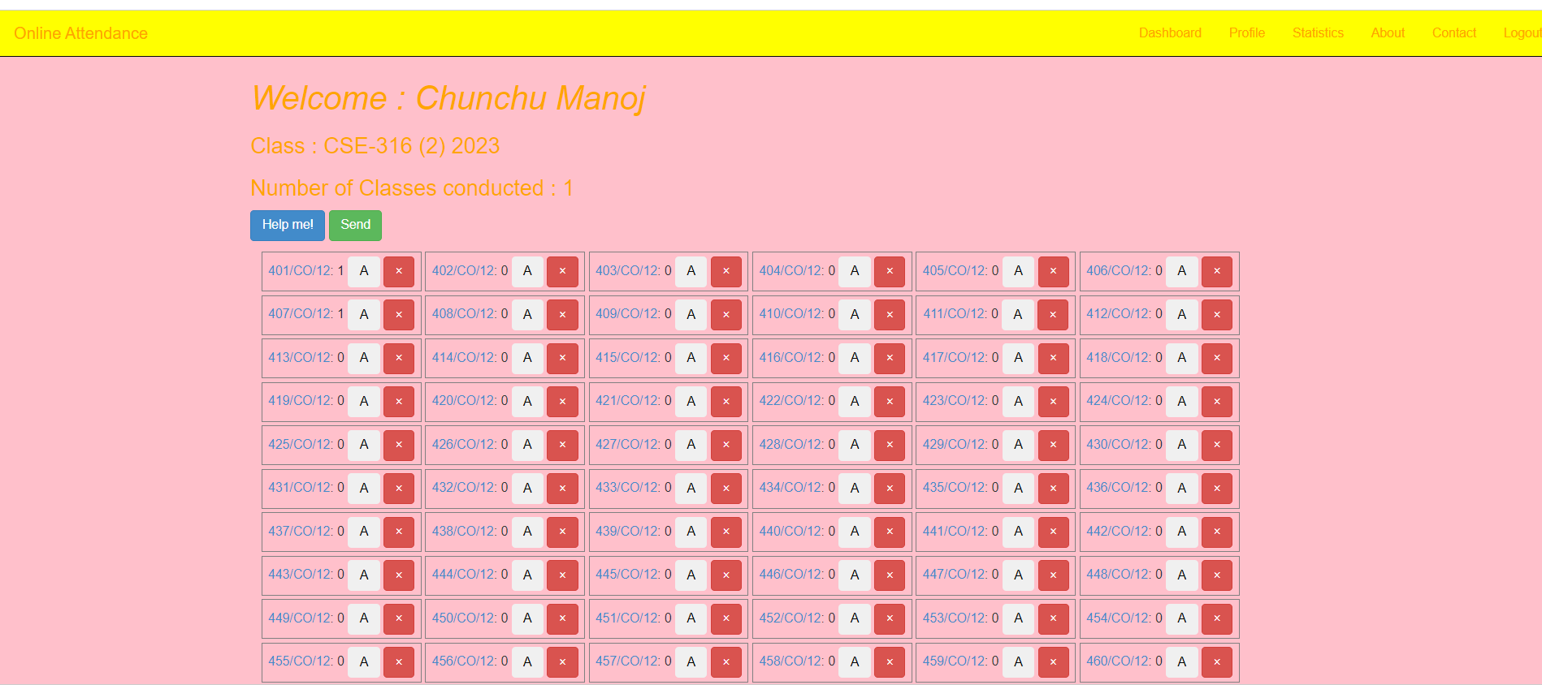
TAKING ATTENDANCE

Slide 20
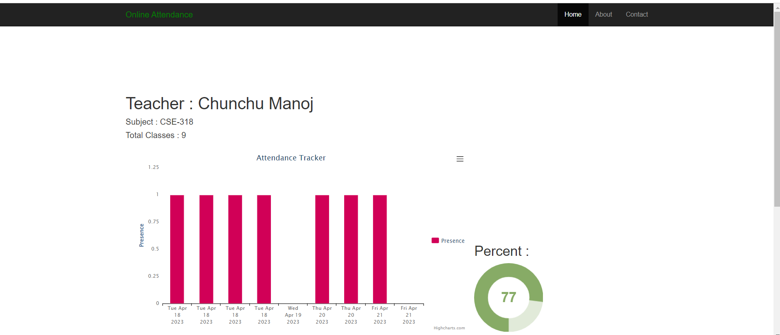
PARTICULAR SUBJECT PERCENTAGE

Slide 21
CONCLUSION
Online attendance system using HTML, CSS, JavaScript, PHP, and MySQL can revolutionize attendance management in universities, and companies.
The system's features, such as real-time data, generating reports, And make it efficient and user-friendly.
While there may be challenges associated with implementing the system, the long-term benefits outweigh the initial costs.
The online attendance system is an excellent example of how technology can simplify and streamline processes, making them more accurate and efficient.

Slide 22
REFERENCES
ASP.NET 2.0 Website Programming: Problem-Design-Solution (Programmer to Programmer) by Marco Bellinaso
Professional ASP.NET 2.0 by Bill Evjen, Scott Hanselman, Farhan
OReilly (E-Book) – Programming in .Net
Oreille (E-Book) – Framework + Essentials.pdf
Beginner ASP.NET 2.0 – Unleashed
PL/SQL Programming – Evan Bayross

Slide 23
REFERENCES
Introducing Microsoft .NET, Second Edition author David S. Platt.
Joe Mayo, “Microsoft Visual Studio 2010: A Beginner's Guide”, Tata McGrawHill, 2010.
Alex Mackey, “Introducing .NET 4.0: With Visual Studio 2010”, Press, USA,2010.

Slide 24
THANK YOU!!!

